Slide 1
slides on MCMC and MLE (now added to intro to SS talk)

Slide 2
Running MCMC
step 1: SS3
step 2: SS3 -mcmc 100000 -mcsave 100 (runs 100,000 draws, saves every 100th)
step 3: SS3 -mceval (evaluates saved draws)
step 4: repeat step 1 to get converged report files overwritten during last Mceval draw

Slide 3
Comparing MCMC to MLE
Normal approximation based on curvature of likelihood surface at MLE
calculated from Hessian matrix by ADMB
MCMC samples from posterior distribution

Slide 4
Comparing MCMC to MLE
Hessian matrix provides correlations between all quantities with standard deviations

Slide 5
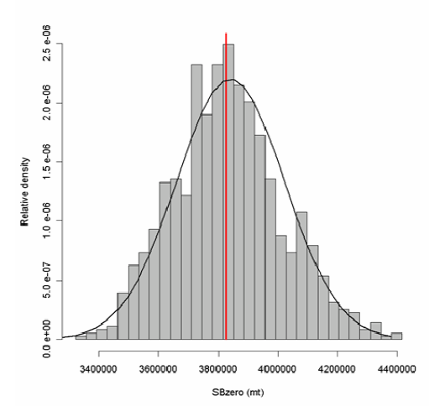
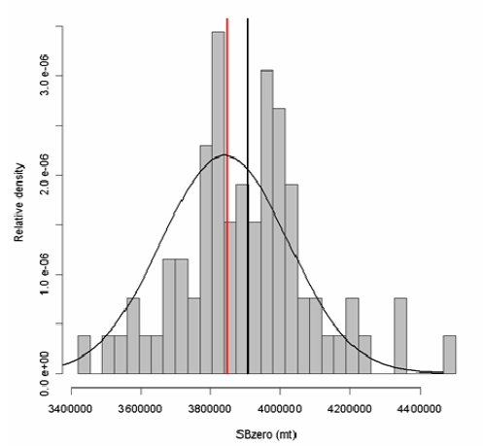
Comparing MLE to parametric bootstrap
Analysis conducted for Pacific Hake in 2006
Grey bars are MCMC
Black line is normal from Hessian
Grey bars are from 75 bootstraps
Black line is normal from Hessian

Slide 6
Notes on comparing MCMC to MLE
Normal approximation at MLE are generally similar to posterior samples form MCMC
depends on same priors (or lack thereof)
parameters with high correlation, or non-normal posterior likely have worse approximation in MLE
Bias adjustment for recruitment residuals is simpler in MCMC mode
should be 100% of adjustment for all years in MCMC
change is automatic in Stock Synthesis, but requires model to be rerun for MCMC

